Slide 1
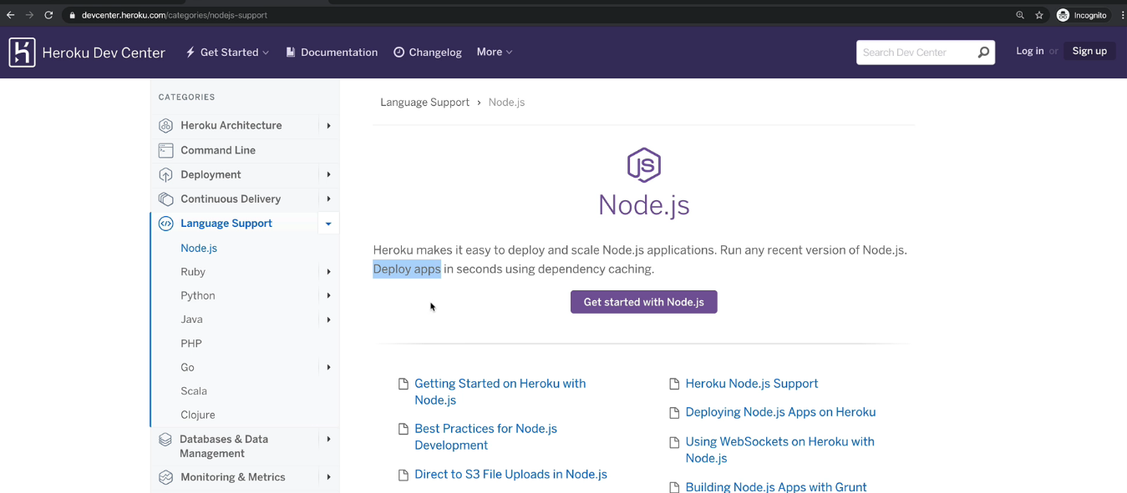
We have to deploy our developed application at
freely available hosting services.

Slide 2
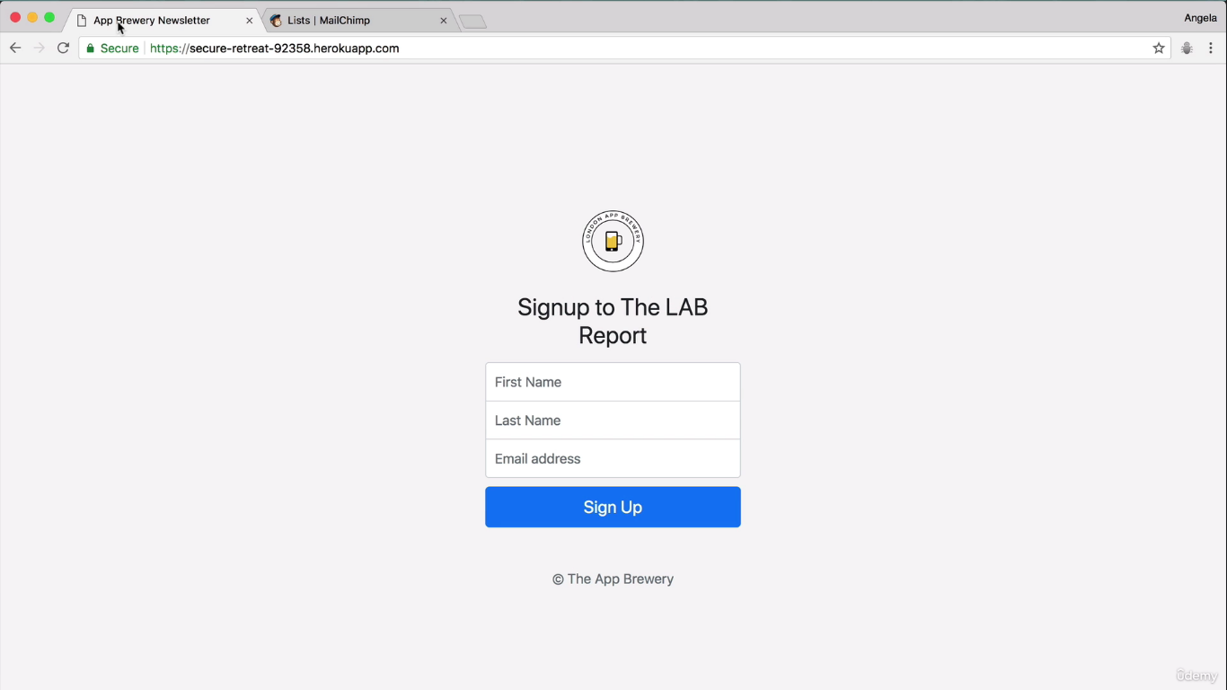
Example : Hosted Application at herokuapp

Slide 3


Slide 4
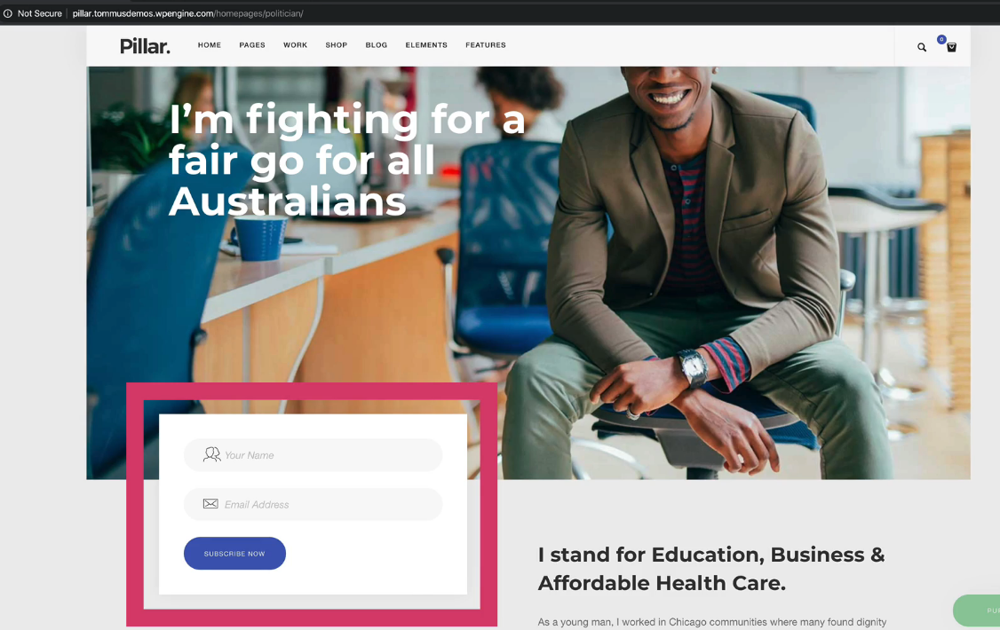

Slide 5
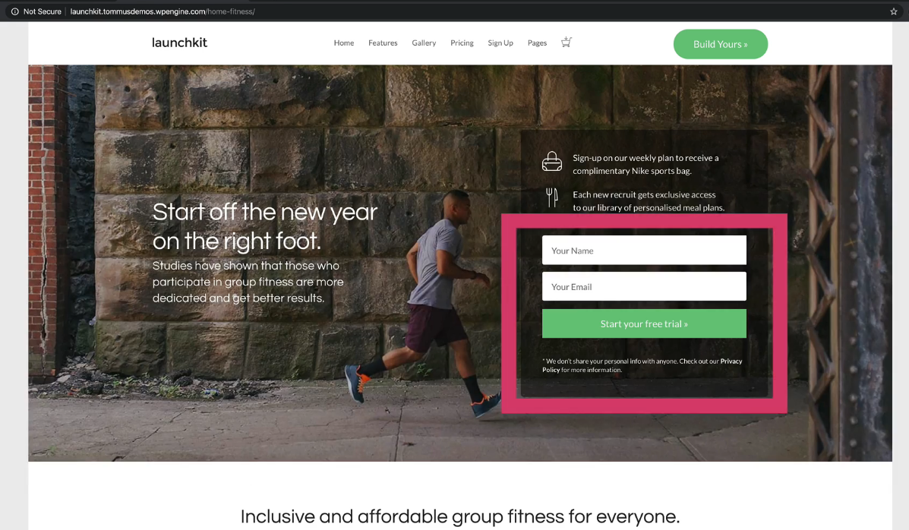

Slide 6
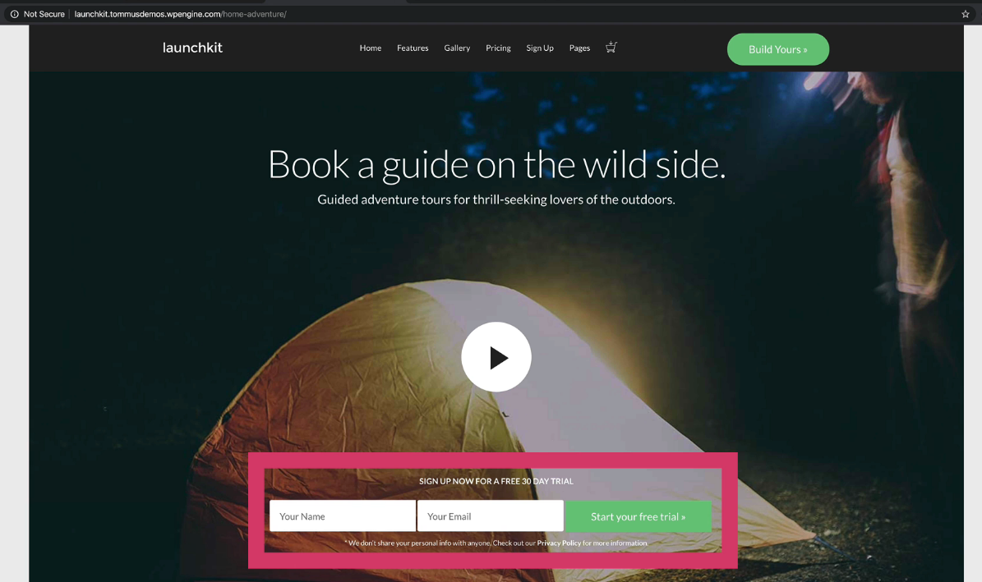

Slide 7
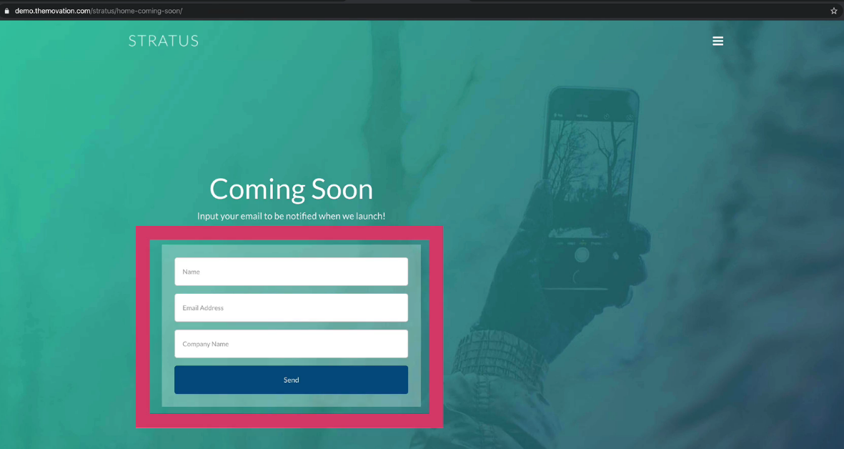

Slide 8
Example : Hosted Application at herokuapp

Slide 9
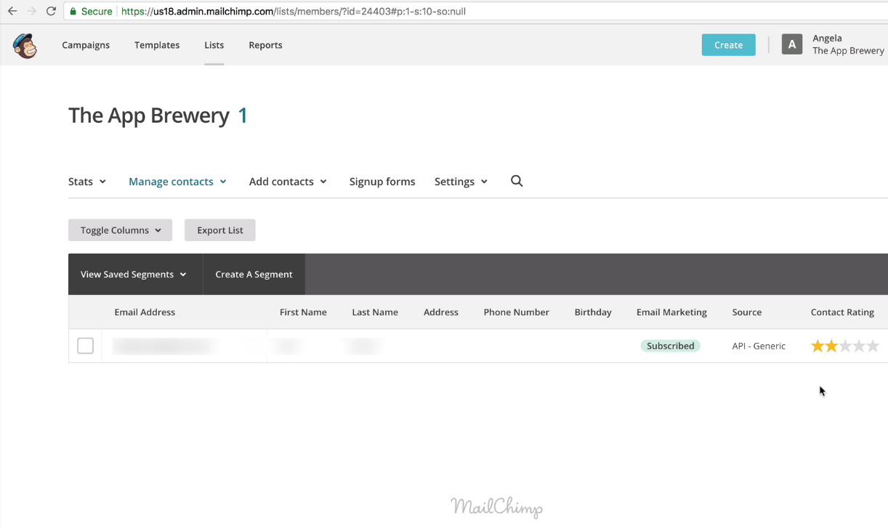
Example : Hosted Application at mailchimp server

Slide 10
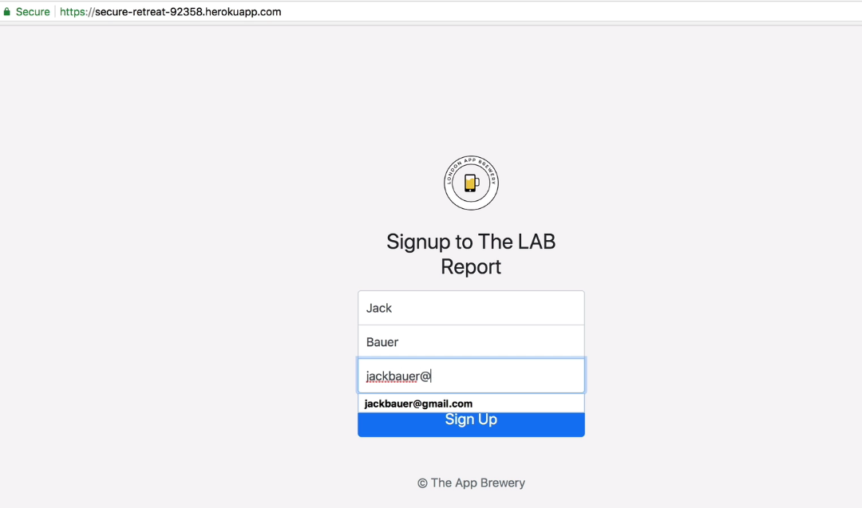
Example : Hosted Application at mailchimp server

Slide 11
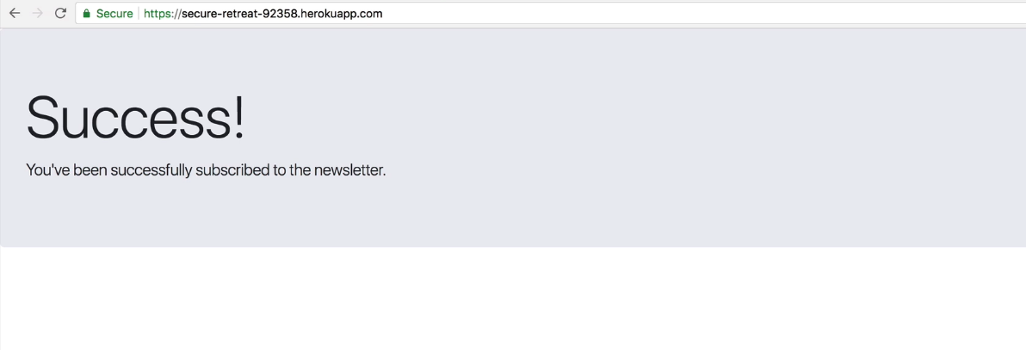
Example : Hosted Application at mailchimp server

Slide 12
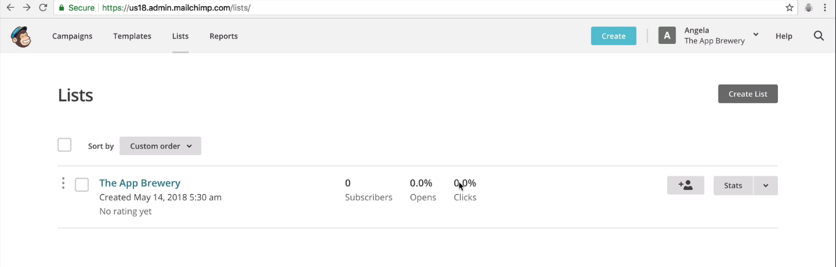
Example : Hosted Application at mailchimp server

Slide 13
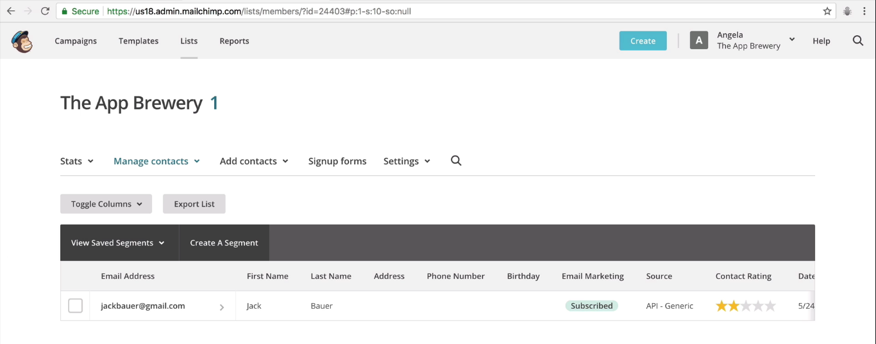

Slide 14
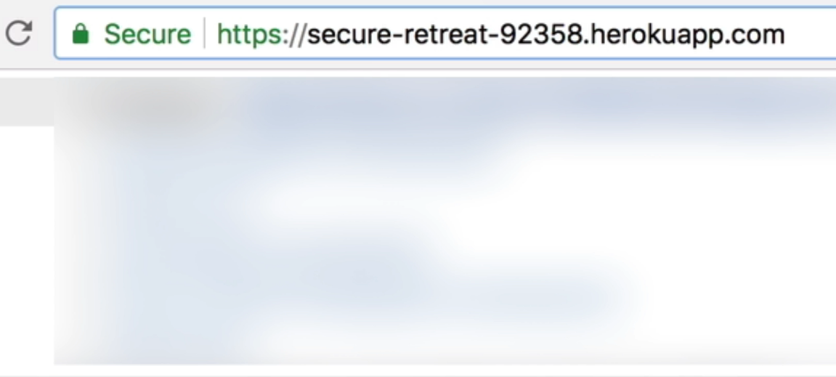
Example : Hosted Application at herokuapp - address

Slide 15
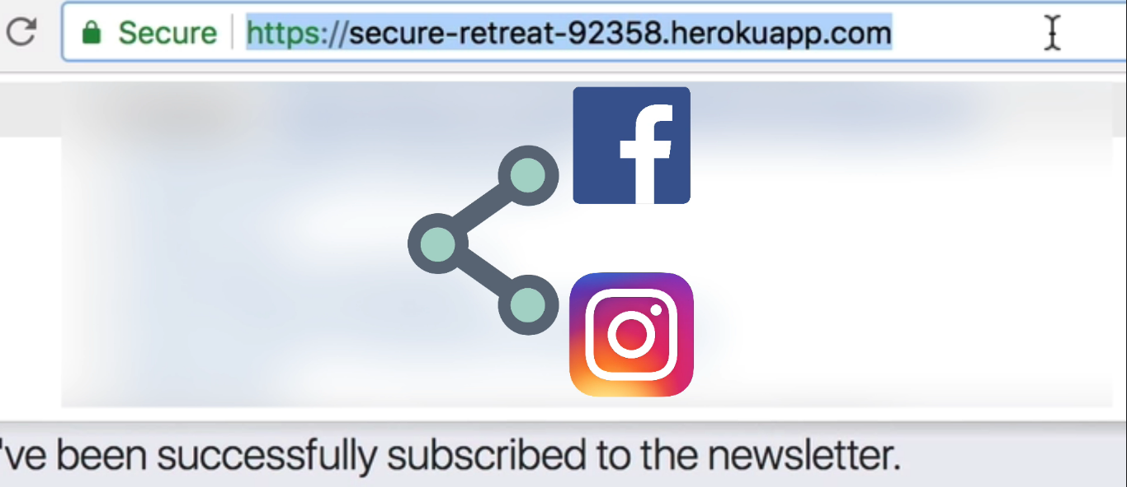
Example : Hosted Application can be shared via this url

Slide 16
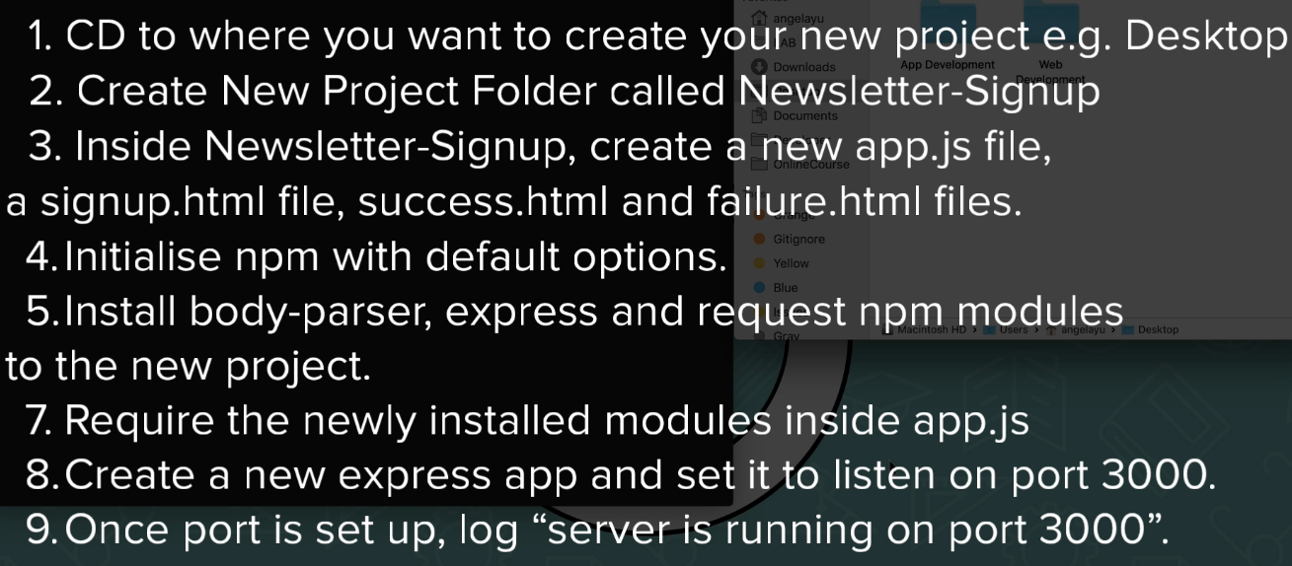
Creating News Letter Application

Slide 17
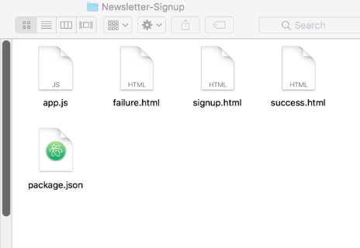
Project folder structure

Slide 18
Install Packages body-parser, express, request

Slide 19
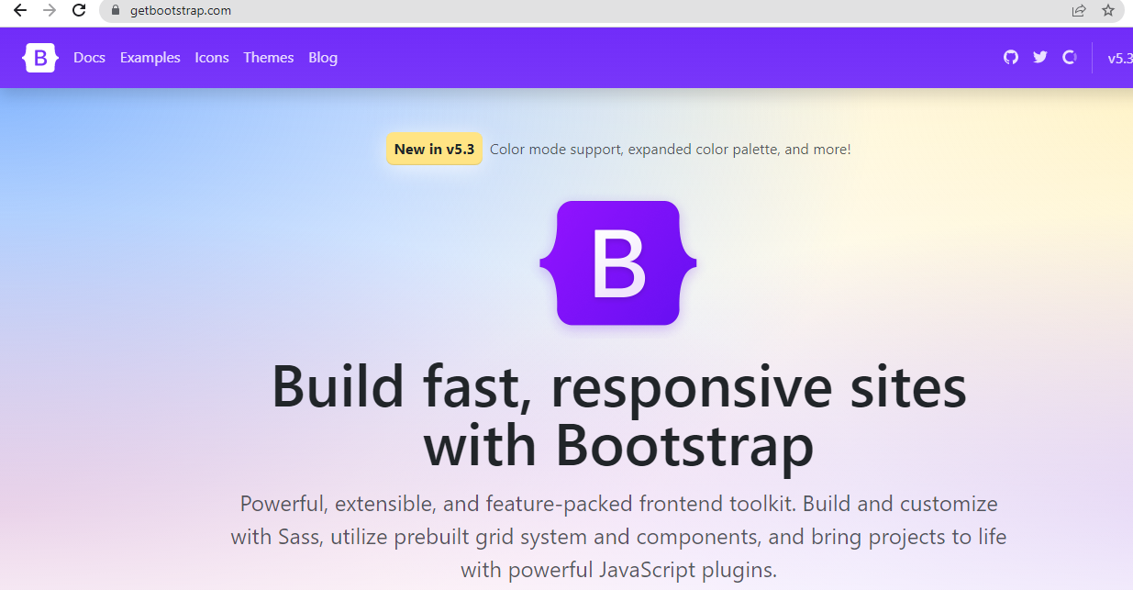
Go to the website getbootstrap.com

Slide 20
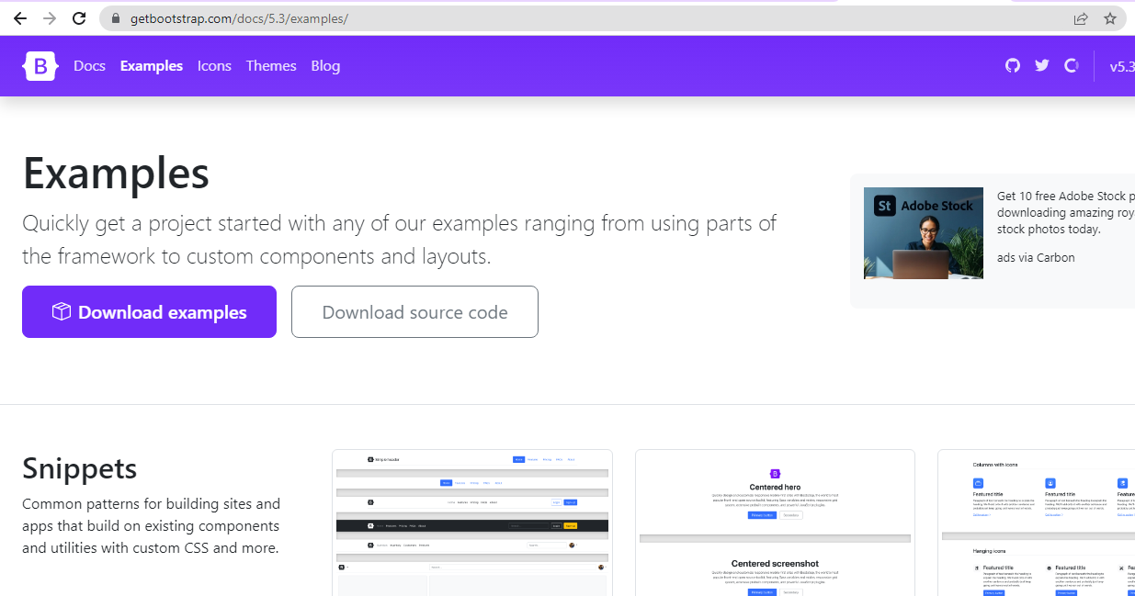
Go to the website getbootstrap.com, Choose examples

Slide 21
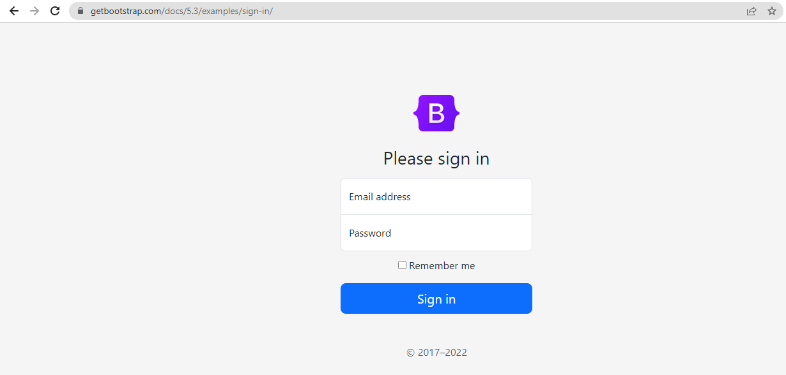
Select Sign in example

Slide 22
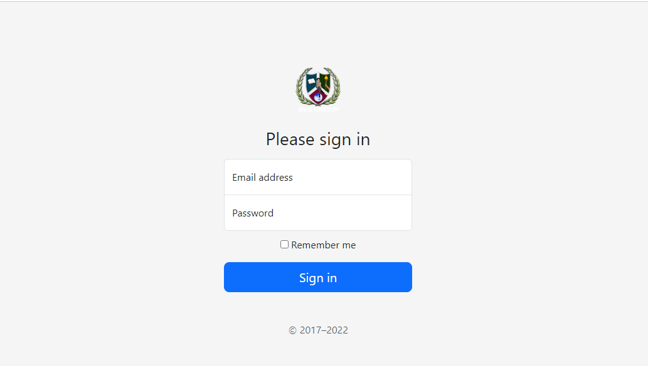
Change that default sign in into our own news letter app
Sign Up Page step by step

Slide 23

Change that default sign in into our own news letter app
Sign Up Page step by step

Slide 24

Change that default sign in into our own news letter app
Sign Up Page step by step

Slide 25
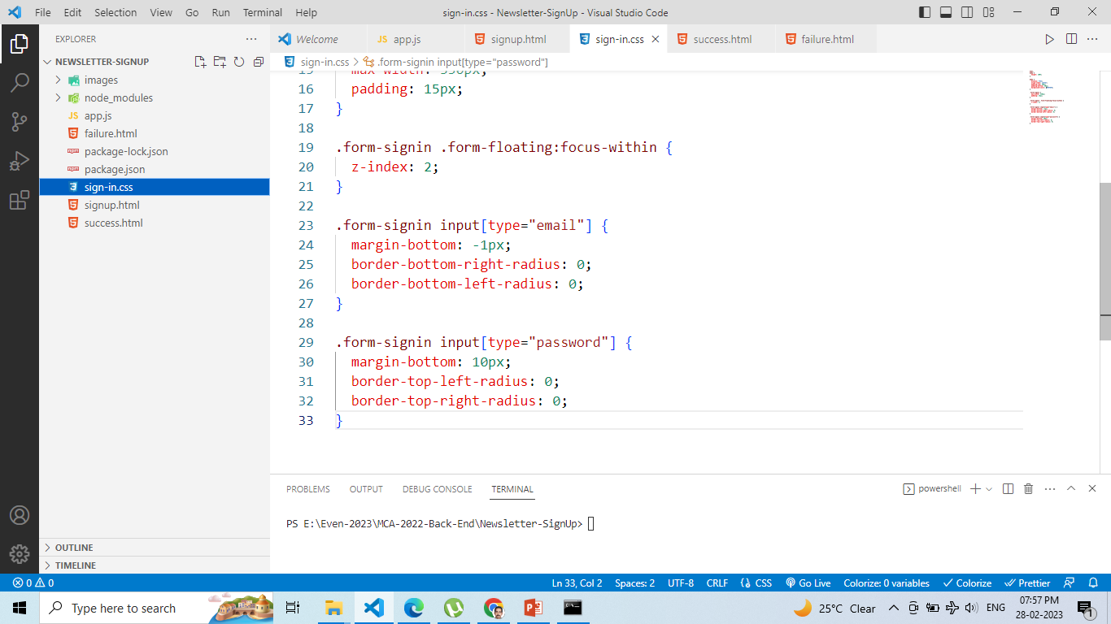
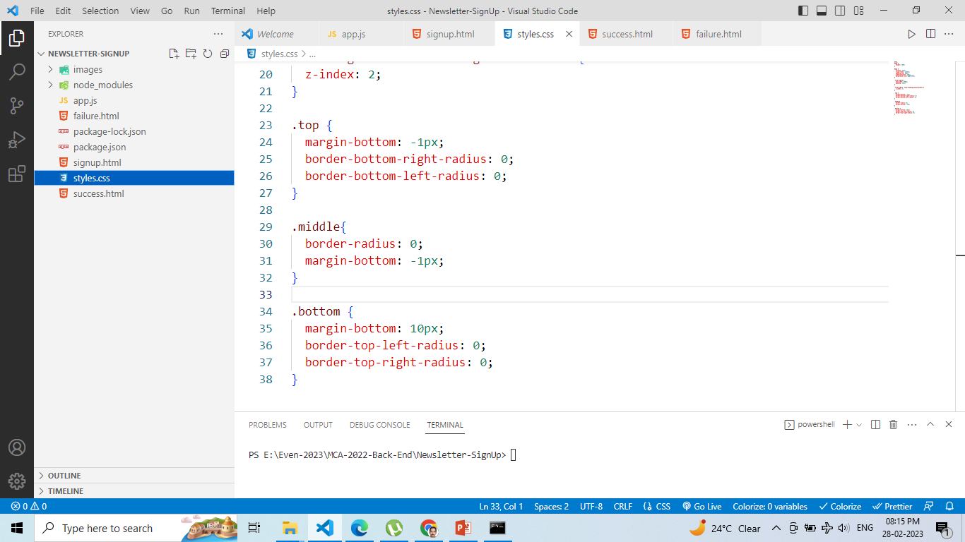
At styles.css file

Slide 26
Change form-signin input[type=“email”] into top class ,
Change form-signin input[type=“password”] into bottom class,
Create a new one class middle and add css properties as like given below

Slide 27
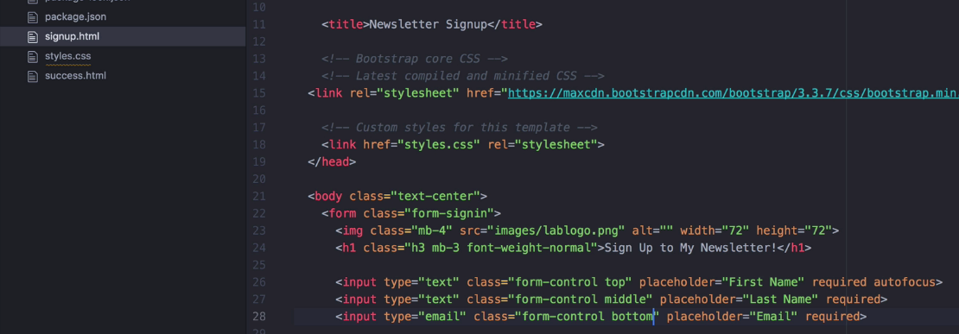
Add class top, middle, bottom at First Name, Last Name
and Email fields in signup.html file

Slide 28
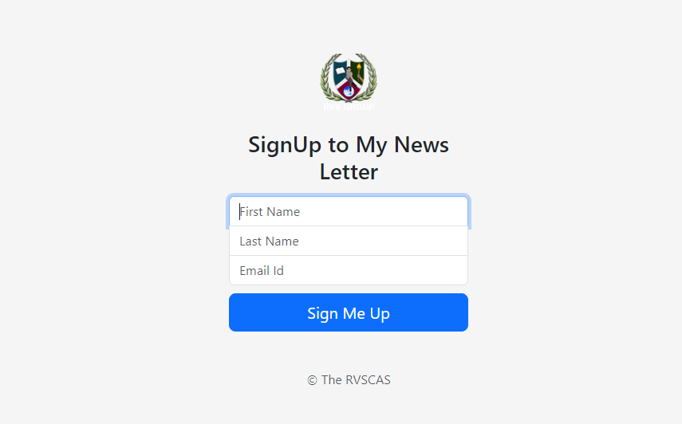

Slide 29
Render signup.html file when running a server using basic get route.

Slide 30
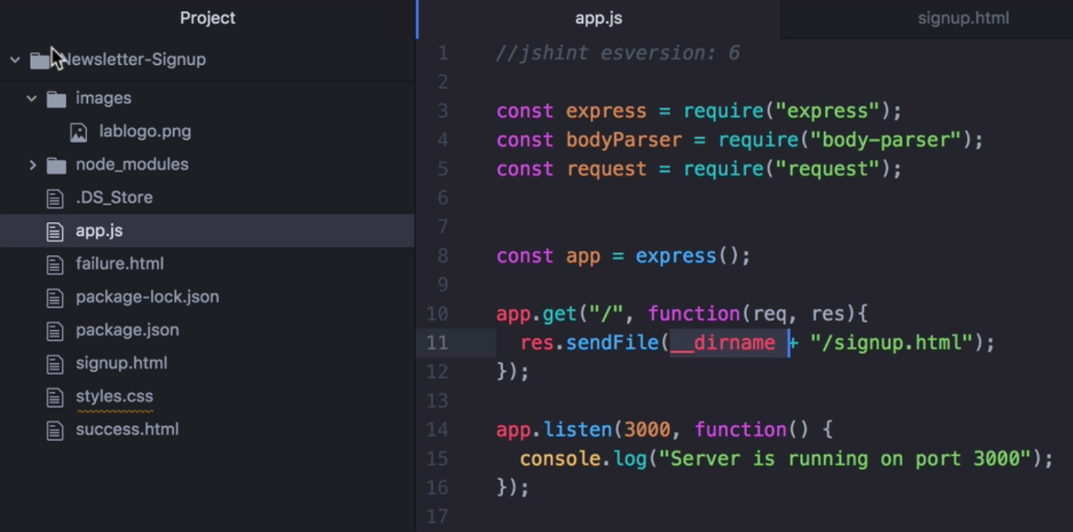

Slide 31
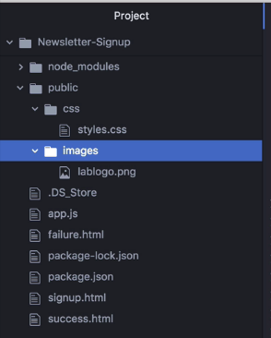
If we load html files and css file when
Server is running in background, we have
to put it in separate folder
named public

Slide 32
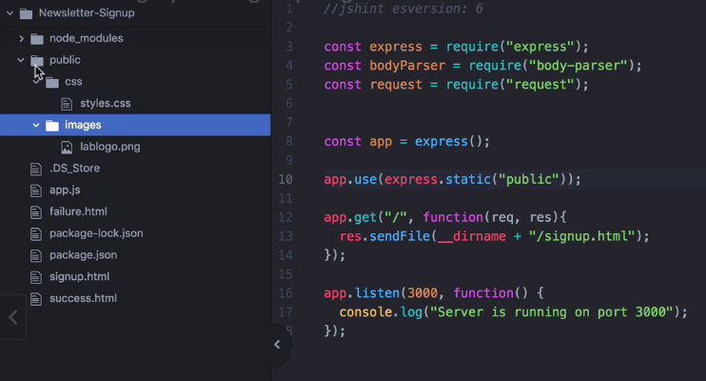
To server static files inside our server, we should use
express.static(“public”) method

Slide 33
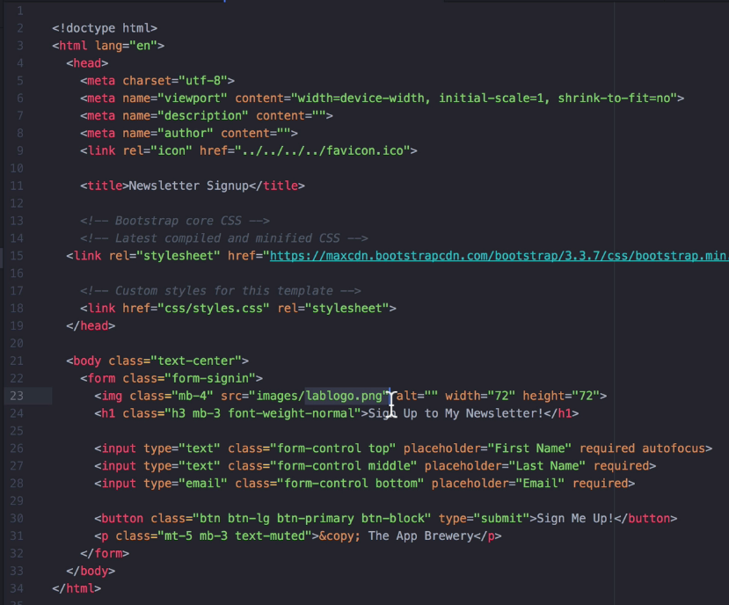
Remember we have to
Change the .css file and
.jpg or .png file path
as relative to public folder

Slide 34
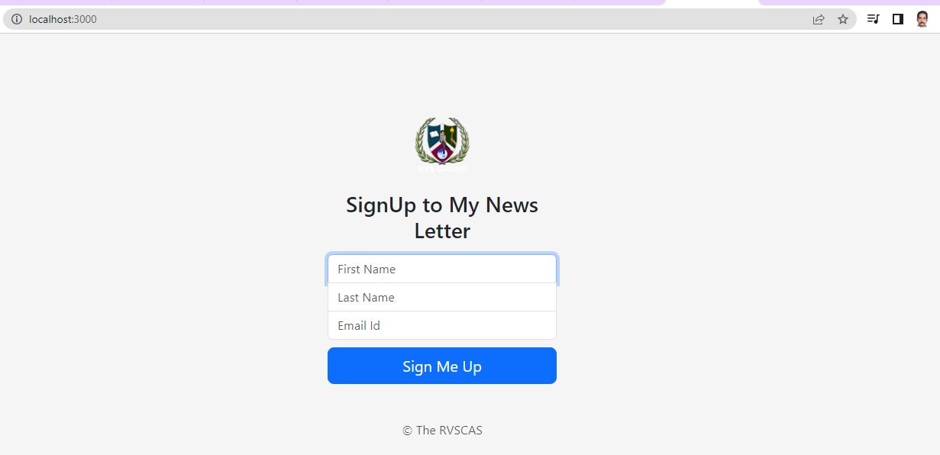

Slide 35
Render given inputs at signup.html file in console.log when running a server using post route and body-parser.

Slide 36
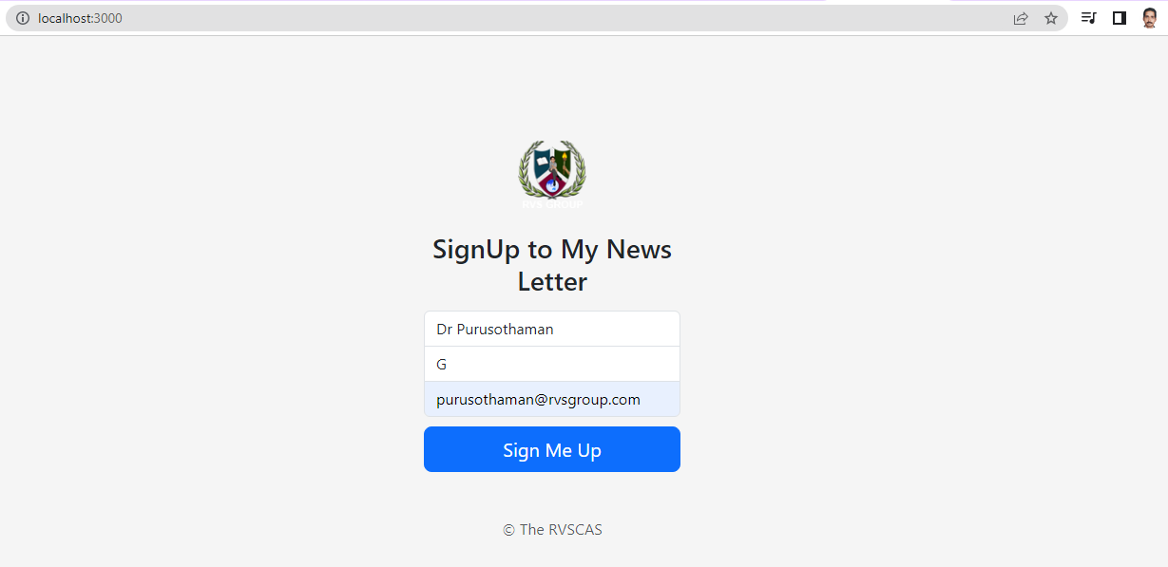

Slide 37
